Slide 1
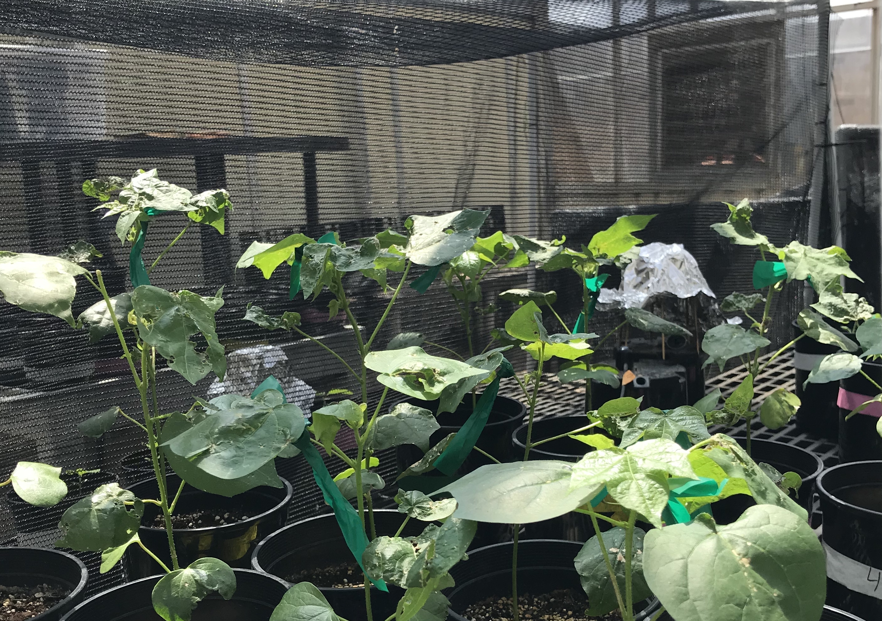
Soil nitrogen fertilization and inoculation modifies carbon costs to acquire nitrogen and leaf water-nitrogen economics in Glycine max L.
EcoHealth Lab Meeting
April 07, 2022
1

Slide 2

Plant nitrogen acquisition is a process in terrestrial systems where carbon and nitrogen are tightly coupled

Slide 3

Plant nitrogen acquisition is a process in terrestrial systems where carbon and nitrogen are tightly coupled
CO₂
Schematic adapted from Brzostek et al. (2014) JGR Biogeosciences
Notes:
This is an overly simplistic schematic that I hope will demonstrate this
Plants draw carbon dioxide in from the atmosphere and convert this to simple sugars

Slide 4
Plant nitrogen acquisition is a process in terrestrial systems where carbon and nitrogen are tightly coupled
CO₂
NPP, growth
Schematic adapted from Brzostek et al. (2014) JGR Biogeosciences
Notes:
This supports net primary production, and allows plants to allocate carbon toward two primary pathways

Slide 5
Plant nitrogen acquisition is a process in terrestrial systems where carbon and nitrogen are tightly coupled
CO₂
NPP, growth
C_{transfer}
C_{growth}
Schematic adapted from Brzostek et al. (2014) JGR Biogeosciences
Notes:
First, plants might use carbon to support whole plant growth. This may be through woody tissue production, leaf production and maintenance, or toward storage
Alternatively, plants might use carbon to support soil resource uptake. This can either be through fine root production, root exudation, or carbon exchange with microbial symbionts

Slide 6
Plant nitrogen acquisition is a process in terrestrial systems where carbon and nitrogen are tightly coupled
CO₂
NPP, growth
C_{transfer}
C_{growth}
N_{growth}
N_{available}
Schematic adapted from Brzostek et al. (2014) JGR Biogeosciences
Notes:
Plants use carbon allocated belowground to acquire important resources that support photosynthetic and metabolic demand.
While there are a ton of different nutrients plants acquire, plants acquire nitrogen in the largest quantity.
Once acquired, nitrogen can be used for maintenance of structural tissue, production and maintenance of photosynthetic enzymes, and many other important functions that are critical for the growth, reproduction, and survival of an individual plant.

Slide 7
Plant nitrogen acquisition is a process in terrestrial systems where carbon and nitrogen are tightly coupled
CO₂
There are inherent carbon costs associated with acquiring nitrogen
NPP, growth
C_{transfer}
C_{growth}
N_{growth}
N_{available}
Schematic adapted from Brzostek et al. (2014) JGR Biogeosciences
Notes:
However, plants are not able to acquire nitrogen without first allocating carbon belowground.
Thus, there are inherent carbon costs associated with acquiring nitrogen.
These can include structural carbon costs associated with root production and maintenance, or active carbon costs associated with exchange of carbon to microbial symbionts.

Slide 8
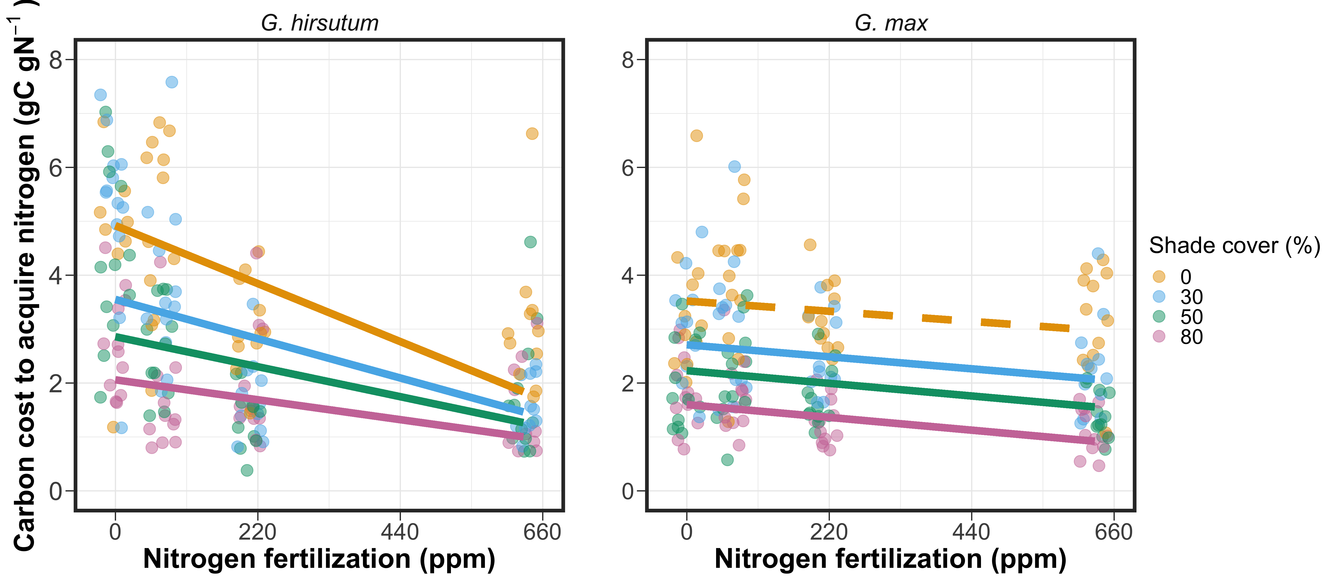
Soil nitrogen availability may decrease carbon costs to acquire nitrogen as a function of increased per-root nitrogen uptake
Perkowski et al. (2021) Journal of Exp. Botany
Notes:
Importantly, carbon costs to acquire nitrogen are dynamic and likely to change with changing aboveground and belowground environmental conditions.
Belowground, soil nitrogen availability likely plays an important role in modifying these carbon costs.
This is because increases in soil nitrogen availability do not influence plant demand to acquire soil resources, and therefore likely do not have a large impact on the magnitude of belowground carbon investments.
Thus, if plants acquire additional nitrogen without a proportional change in belowground carbon, then carbon costs to acquire nitrogen would likely decrease with increasing soil nitrogen availability.
This could be indexed through increased per-root nitrogen uptake in species that acquire most of their nitrogen through direct uptake

Slide 9
Soil nitrogen availability may decrease carbon costs to acquire nitrogen as a function of increased per-root nitrogen uptake
Perkowski et al. (2021) Journal of Exp. Botany
Notes:
This was observed in one of my previous experiments, where carbon costs to acquire nitrogen decreased with nitrogen fertilization in cotton and soybean
However, we observed differences in the magnitude of the nitrogen fertilization effect on carbon costs to acquire nitrogen between cotton and soybean
We thought this might be driven by differences in species acquisition strategy, since cotton acquires nitrogen through arbuscular mycorrhizal associations or direct uptake, while soybean acquires nitrogen through forming associations with nitrogen fixing bacteria or arbuscular mycorrhizae, or through direct uptake
However, we were limited in our ability to suggest whether these differences were driven by acquisition strategy or species identity, since cotton and soybean are not closely related phylogenetically and have different life history traits

Slide 10
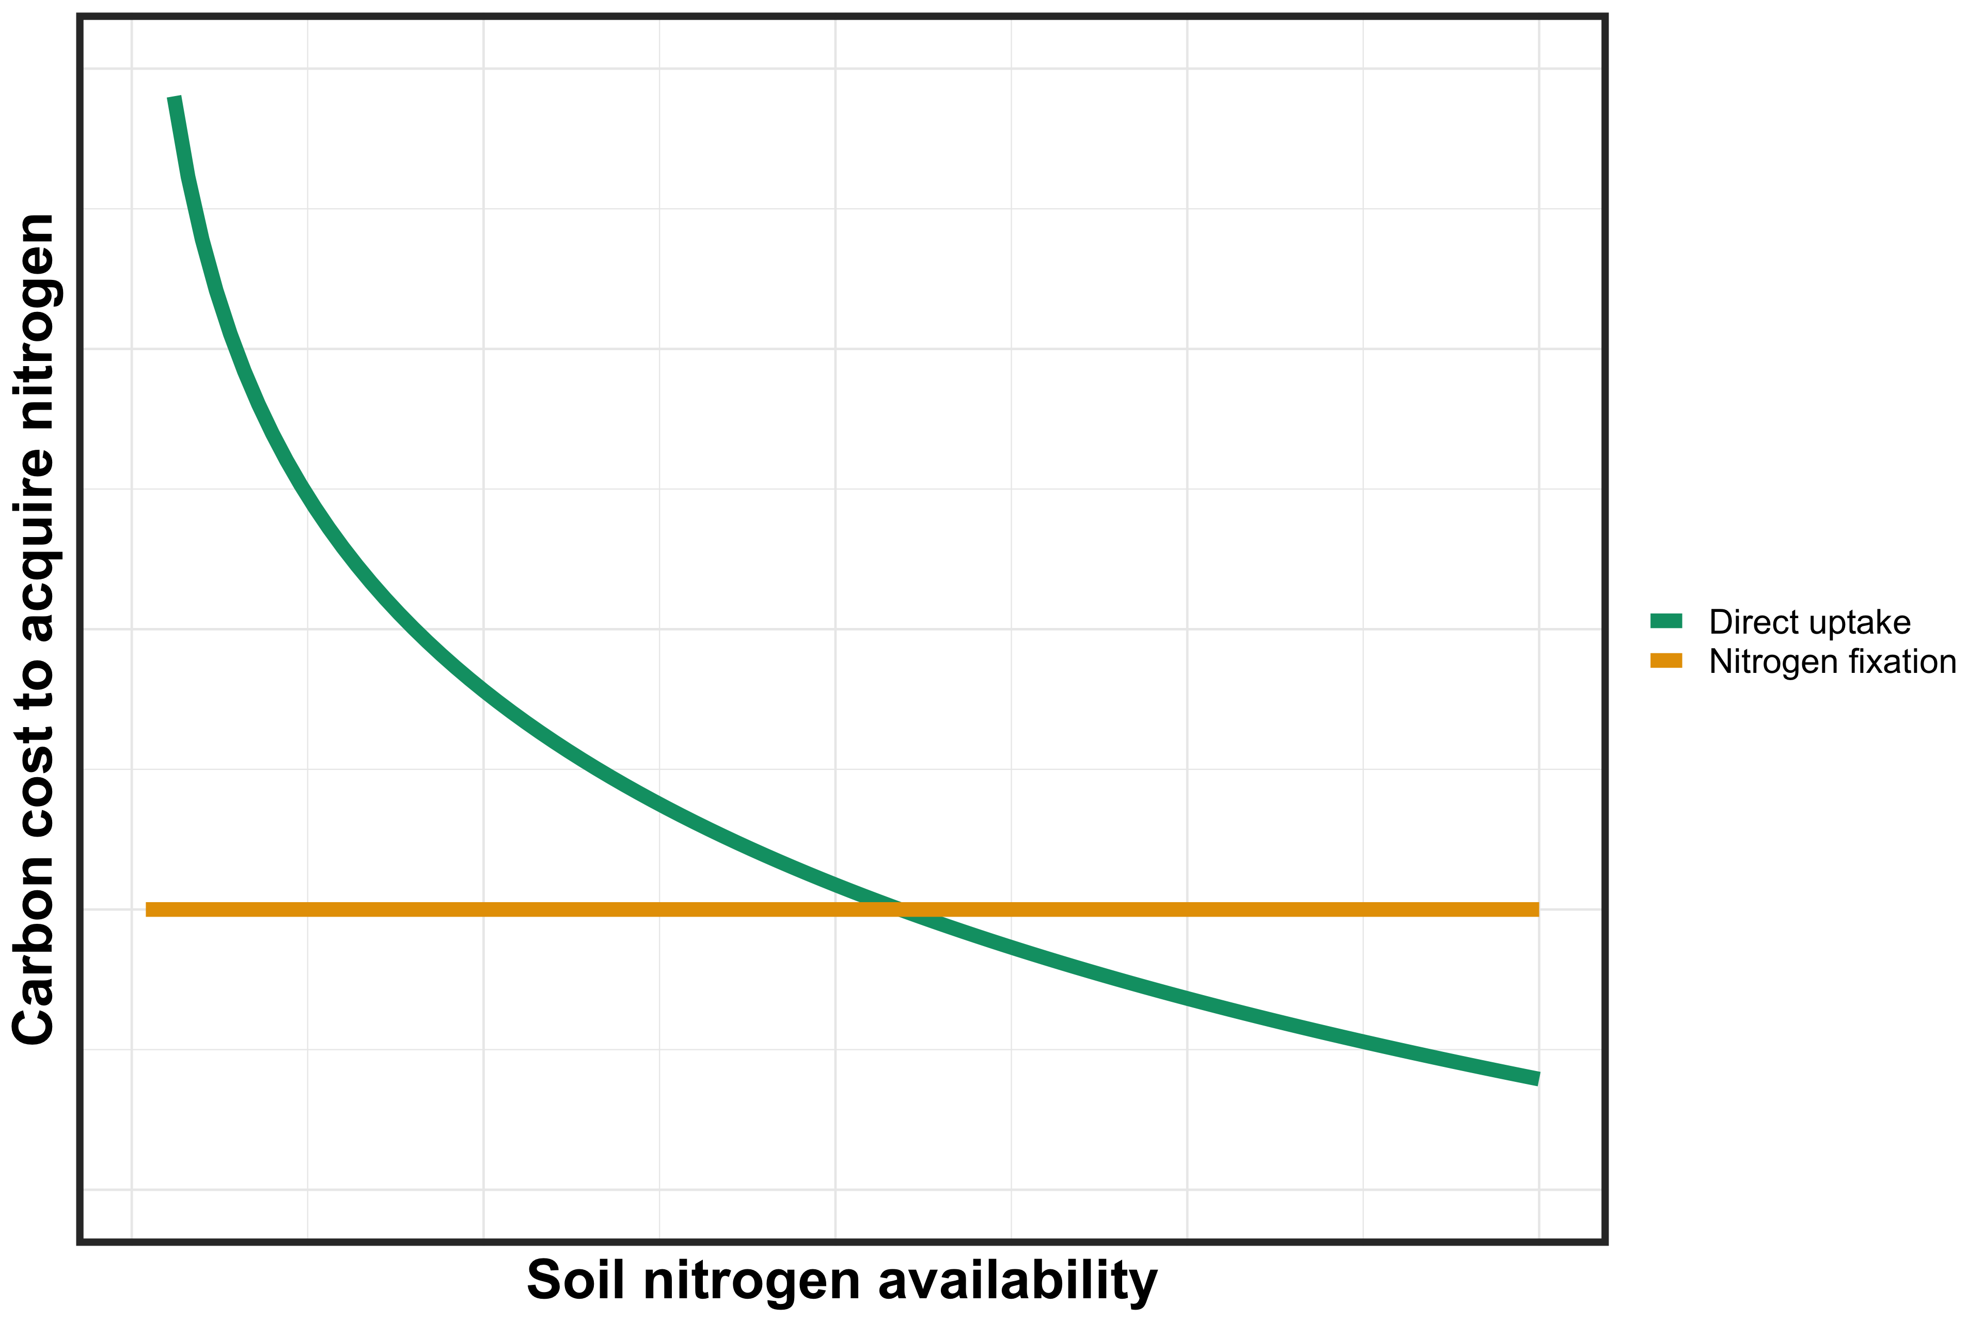
However, effects of soil nitrogen availability on carbon costs to acquire nitrogen may be context dependent on species nitrogen acquisition strategy
Notes:
While we were unable to determine whether species differences were driven by species identity or acquisition strategy, effects of soil nitrogen availability on carbon costs to acquire nitrogen are liekyl context dependent on species nitrogen acquisition strategy.
This figure describes the hypothesized relationship between soil nitrogen availability, represented on the x-axis, and carbon costs to acquire nitrogen, represented on the y-axis between two nitrogen acquisition strategies

Slide 11
However, effects of soil nitrogen availability on carbon costs to acquire nitrogen may be context dependent on species nitrogen acquisition strategy
Notes:
Following resource optimization theory, species who associate with nitrogen-fixing bacteria should have lower carbon costs to acquire nitrogen than species that acquire nitrogen via direct uptake when soil nitrogen is less available.
This may pose a competitive advantage to species that associate with nitrogen fixing bacteria, as species would be able to acquire more nitrogen from a carbon investment
However, as soil nitrogen availability increases, species that acquire nitrogen via direct uptake experience decreased carbon costs to acquire nitrogen, likely as a function of increased per-root nitrogen uptake.
Eventually, this may lead to a scenario where it is more advantageous for species to acquire nitrogen from direct uptake pathways than through nitrogen fixation, and could cause nitrogen-fixing species to switch away from nitrogen fixation to direct uptake to maximize nitrogen uptake from a belowground carbon investment

Slide 12
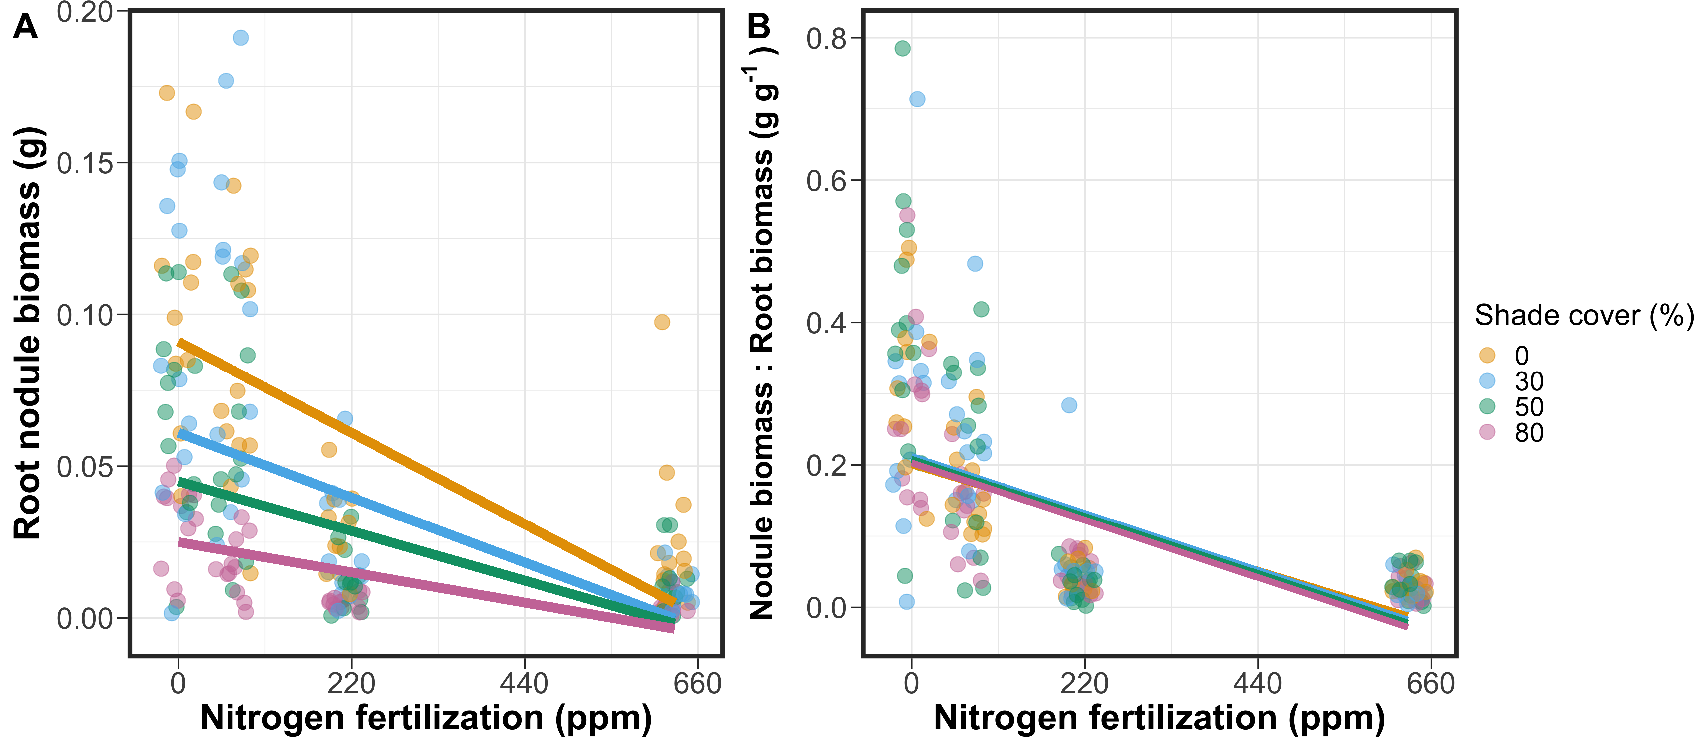
Increasing soil nitrogen availability should reduce nitrogen acquisition via nitrogen fixation due to a shift toward direct uptake
Perkowski et al. (2021) Journal of Exp. Botany
Notes:
This is indeed what we inferred from previous work, where nitrogen fertilization decreased root nodule biomass
Interestingly, the ratio of nodule biomass to root biomass also decreased with increasing nitrogen fertilization.
This indicates a possible shift toward direct uptake as the dominant acquisition strategy with increasing soil nitrogen fertilization

Slide 13
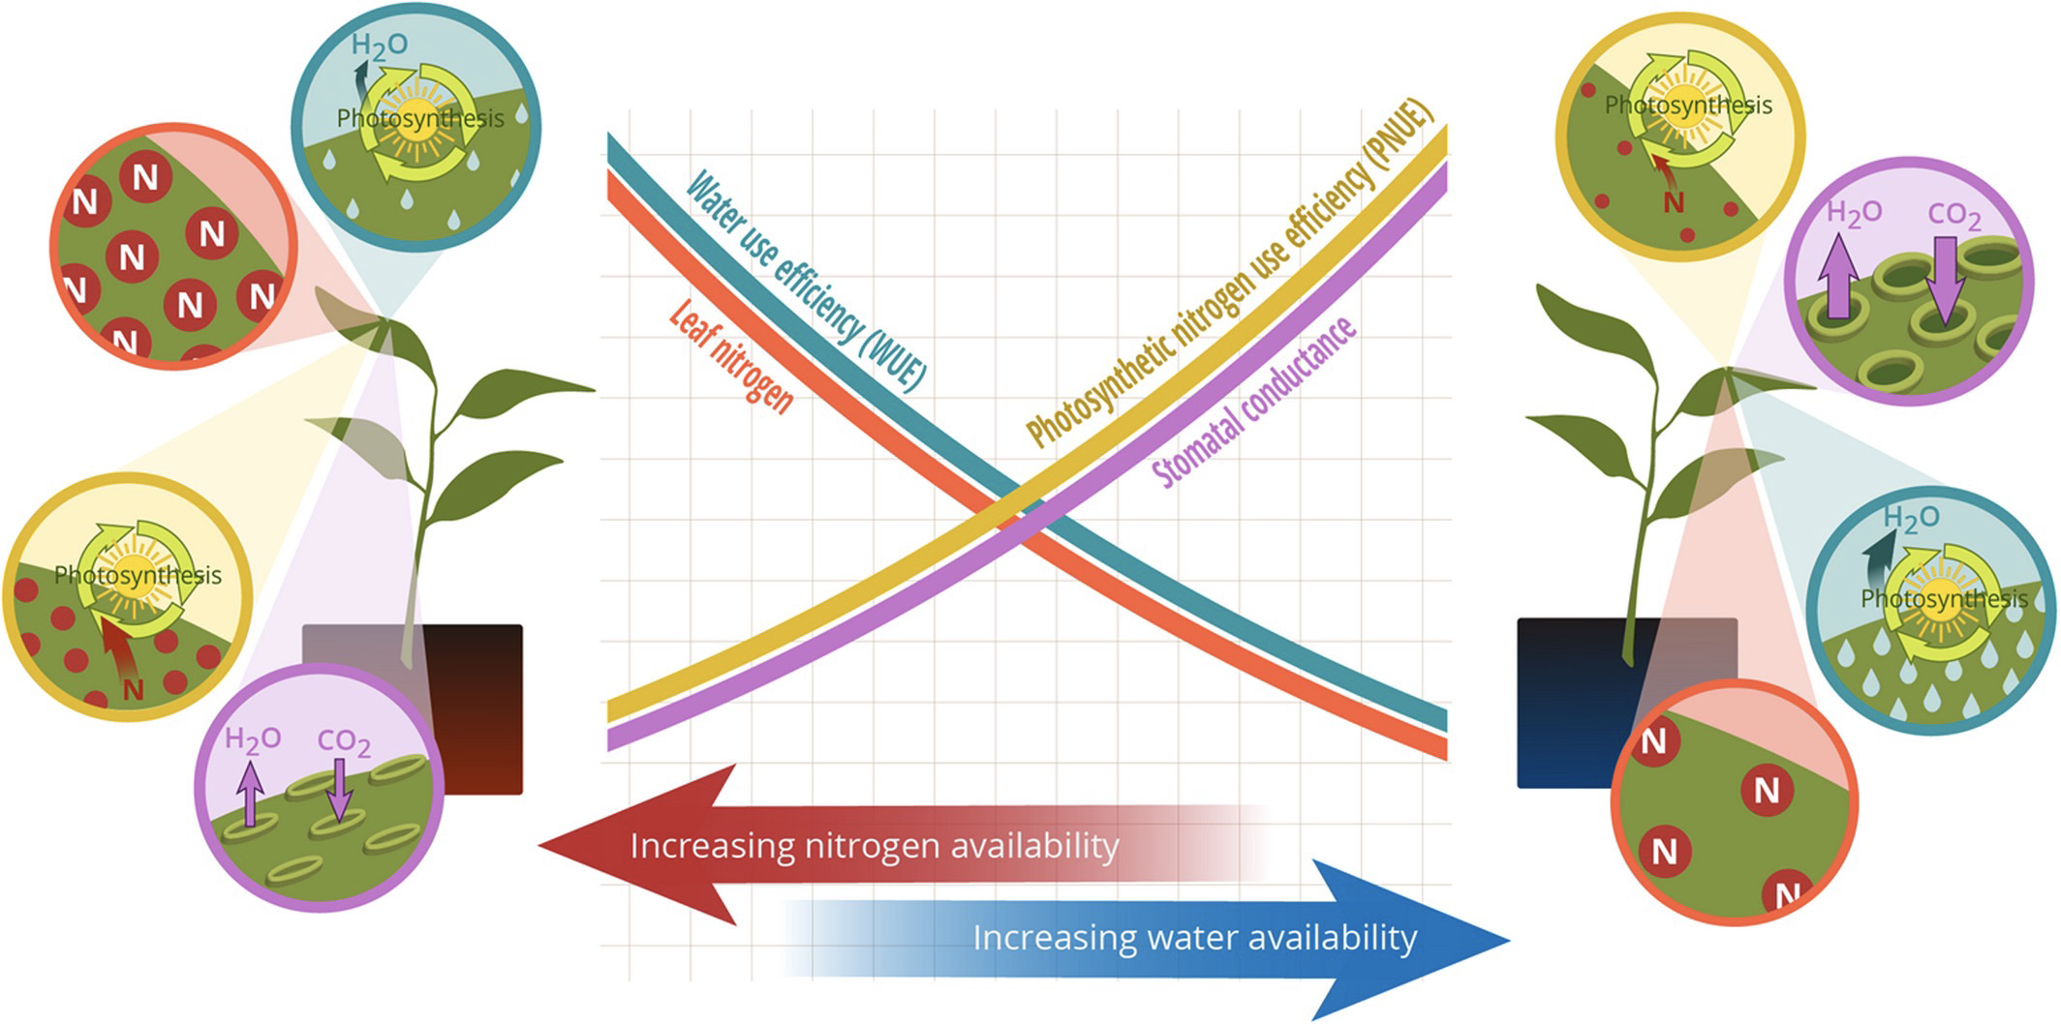
Shifts in carbon costs to acquire nitrogen may result in alterations in plant nutrient allocation strategies
Bialic-Murphy et al. (2021) Ecol. Letters
Notes:
We might also expect shifts in carbon costs to acquire nitrogen due to acquisition strategy or nitrogen fertilization to modify leaf nutrient allocation decisions.
For example, plants may allocate nitrogen to leaf tissue such that unit costs of water and nitrogen use are minimized, where individuals can swap efficient use of a less abundant resource for inefficient use of a more abundant resource.
For example, as you can see in this figure, and increase in nitrogen availability should result in an increase in leaf nitrogen allocation as a means to increase water-use efficiency with less efficient nitrogen usage

Slide 14
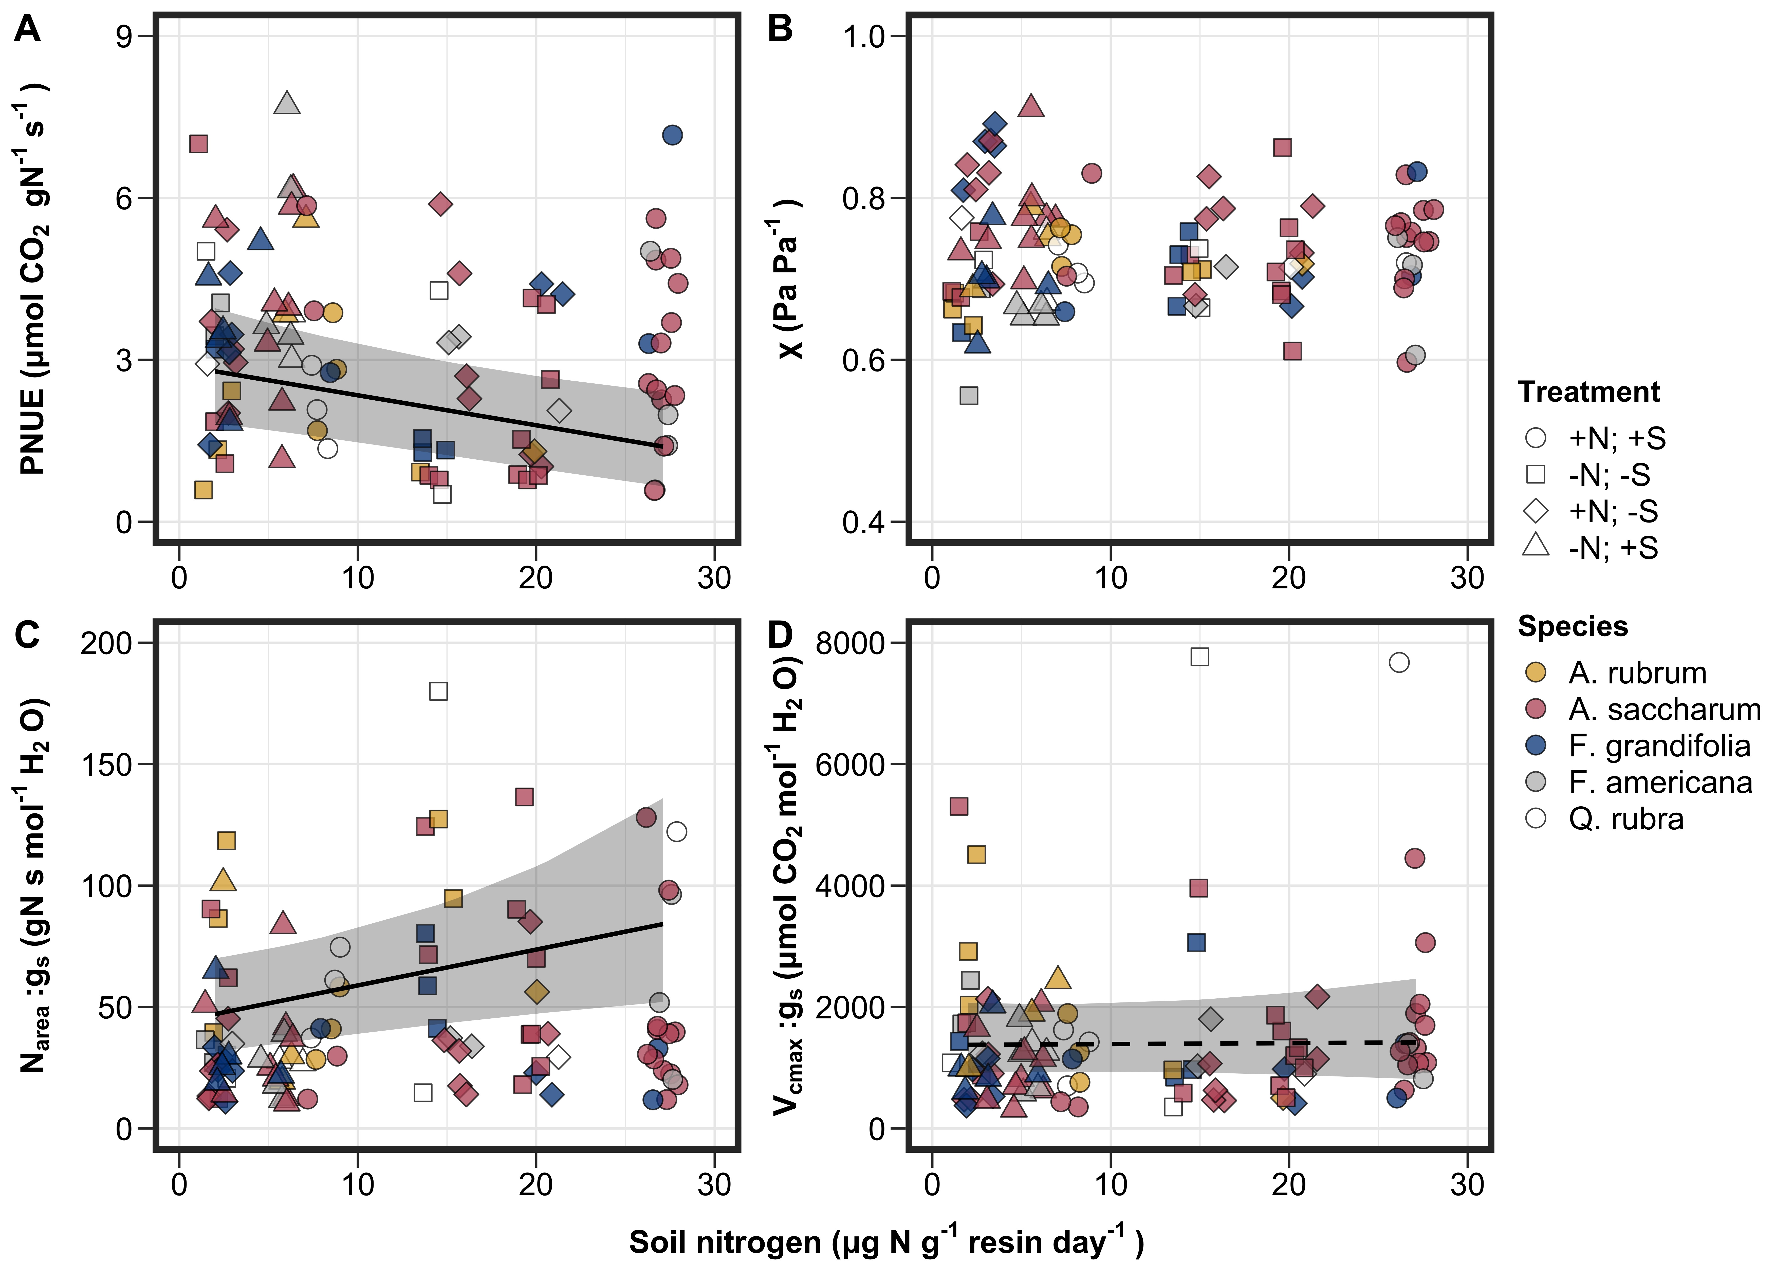
Increases in soil nitrogen availability seem to modify leaf nitrogen-water economies…
Perkowski et al. (in prep)
Notes:
This is a pattern I’ve observed in previous work, where increasing nitrogen availability decreases photosynthetic nitrogen-use efficiency and increases leaf nitrogen allocation per stomatal conductance.

Slide 15
Increases in soil nitrogen availability seem to modify leaf nitrogen-water economies… what about acquisition strategy?
Perkowski et al. (in prep)
Notes:
But we currently do not fully understand how acquisition strategy might modify tradeoffs between nitrogen and water usage

Slide 16
Shifts in carbon costs to acquire nitrogen may result in alterations in plant nutrient allocation strategies
Decreasing N_{cost}
Bialic-Murphy et al. (2021) Ecol. Letters
Notes:
For example, if increasing nitrogen availability decreases carbon costs to acquire nitrogen, then we would expect that reductions in carbon costs to acquire nitrogen to similarly increase leaf nitrogen allocation to maximize water-use efficiency with less efficient nitrogen usage and increased leaf nitrogen allocation per stomatal conductance
Lower carbon costs to acquire nitrogen in nitrogen-fixing species under low soil nitrogen may also result in similar responses in comparison to species that acquire nitrogen via direct uptake or with mycorrhizal associations

Slide 17
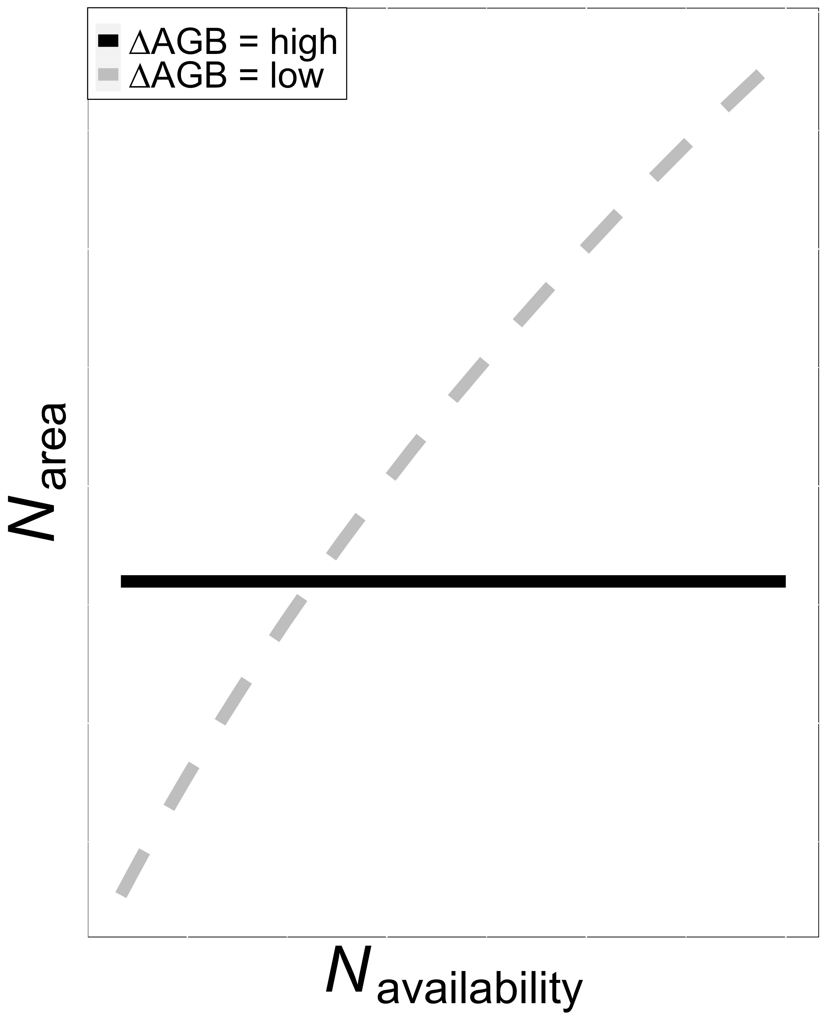
Shifts in carbon costs to acquire nitrogen may result in alterations in plant nutrient allocation strategies (cont.)
Smith et al. (in prep)
Notes:
However, these responses should depend on leaf and whole plant allocation decisions.
For example, if increasing soil nitrogen availability increases whole plant growth, then we might expect dampened effects of soil nitrogen availability on leaf nitrogen allocation
As effects of soil nitrogen availability on whole plant growth diminish, we would expect to observe stronger leaf responses to soil nitrogen availability

Slide 18
Shifts in carbon costs to acquire nitrogen may result in alterations in plant nutrient allocation strategies (cont.)
Decreasing N_{cost}
Smith et al. (in prep)
Notes:
We would expect carbon costs to acquire nitrogen to have similar effects on tradeoffs between whole plant growth and leaf nitrogen allocation
However, we do not fully understand what drives investment in whole plant vs. leaf level processes, and the inherent role of acquisition strategy in modifying these tradeoffs
Further, our previous work notes species differences in carbon costs to acquire nitrogen, but we were not able to determine a causal role explaining the interspecies variation

Slide 19
Research Questions
How does nitrogen fixation and soil nitrogen availability influence plant carbon costs to acquire nitrogen?
Notes:
So, Joseph, Nick, and I designed an experiment that would allow us to better target the role of species acquisition strategy and soil nitrogen fertilization on carbon costs to acquire nitrogen…

Slide 20
Research Questions
How does nitrogen fixation and soil nitrogen availability influence plant carbon costs to acquire nitrogen?
How does nitrogen fixation and soil nitrogen availability modify leaf nitrogen-water economics?
Notes:
… leaf nitrogen-water economics….

Slide 21
Research Questions
How does nitrogen fixation and soil nitrogen availability influence plant carbon costs to acquire nitrogen?
How does nitrogen fixation and soil nitrogen availability modify leaf nitrogen-water economics?
How does nitrogen fixation and soil nitrogen availability modify tradeoffs between leaf nitrogen allocation and whole plant growth?
Notes:
and tradeoffs between leaf nitrogen allocation and whole plant growth.

Slide 22
Experimental setup
16 replicates per treatment combination
x
Soil fertilization
Inoculation with
B. japonicum
70 ppm N
+ BNF
630 ppm N
- BNF
A/C_{i} curves and dark respiration measurements completed ~5-6 weeks after experiment initiation
Destructive harvest of focal leaves immediately following curves
Destructive harvest of all organs ~1 week after photosynthetic measurements
Notes:
We set up a greenhouse experiment where we grew G. max under two soil nitrogen levels and manipulated inoculation status in a full factorial, random block design.

Slide 23
Experimental setup
16 replicates per treatment combination
x
Soil fertilization
Inoculation with
B. japonicum
70 ppm N
+ BNF
630 ppm N
- BNF
A_{net}/C_{i} curves and dark respiration measurements completed ~6 weeks after experiment initiation
Destructive harvest of focal leaves immediately following curves
Destructive harvest of all organs ~1 week after photosynthetic measurements
Notes:
We set up a greenhouse experiment where we grew G. max under two soil nitrogen levels and manipulated inoculation status in a full factorial, random block design.

Slide 24
Experimental setup
16 replicates per treatment combination
x
Soil fertilization
Inoculation with
B. japonicum
70 ppm N
+ BNF
630 ppm N
- BNF
A_{net}/C_{i} curves and dark respiration measurements completed ~6 weeks after experiment initiation
Destructive harvest of focal leaves immediately following curves
Destructive harvest of all organs ~1 week after photosynthetic measurements
Notes:
We set up a greenhouse experiment where we grew G. max under two soil nitrogen levels and manipulated inoculation status in a full factorial, random block design.

Slide 25
Experimental setup
16 replicates per treatment combination
x
Soil fertilization
Inoculation with
B. japonicum
70 ppm N
+ BNF
630 ppm N
- BNF
A_{net}/C_{i} curves and dark respiration measurements completed ~6 weeks after experiment initiation
Destructive harvest of focal leaves immediately following curves
Destructive harvest of all organs ~1 week after photosynthetic measurements
Notes:
We set up a greenhouse experiment where we grew G. max under two soil nitrogen levels and manipulated inoculation status in a full factorial, random block design.

Slide 26
Plant measurements
Leaf measurements
Whole plant measurements
Net photosynthesis and biochemical process rates
Leaf nitrogen allocation
PNUE, iWUE
N_{area}:g_{s}, V_{cmax}:g_{s}
Structural carbon costs to acquire nitrogen
Whole plant biomass
Total leaf area

Slide 27
Results

Slide 28
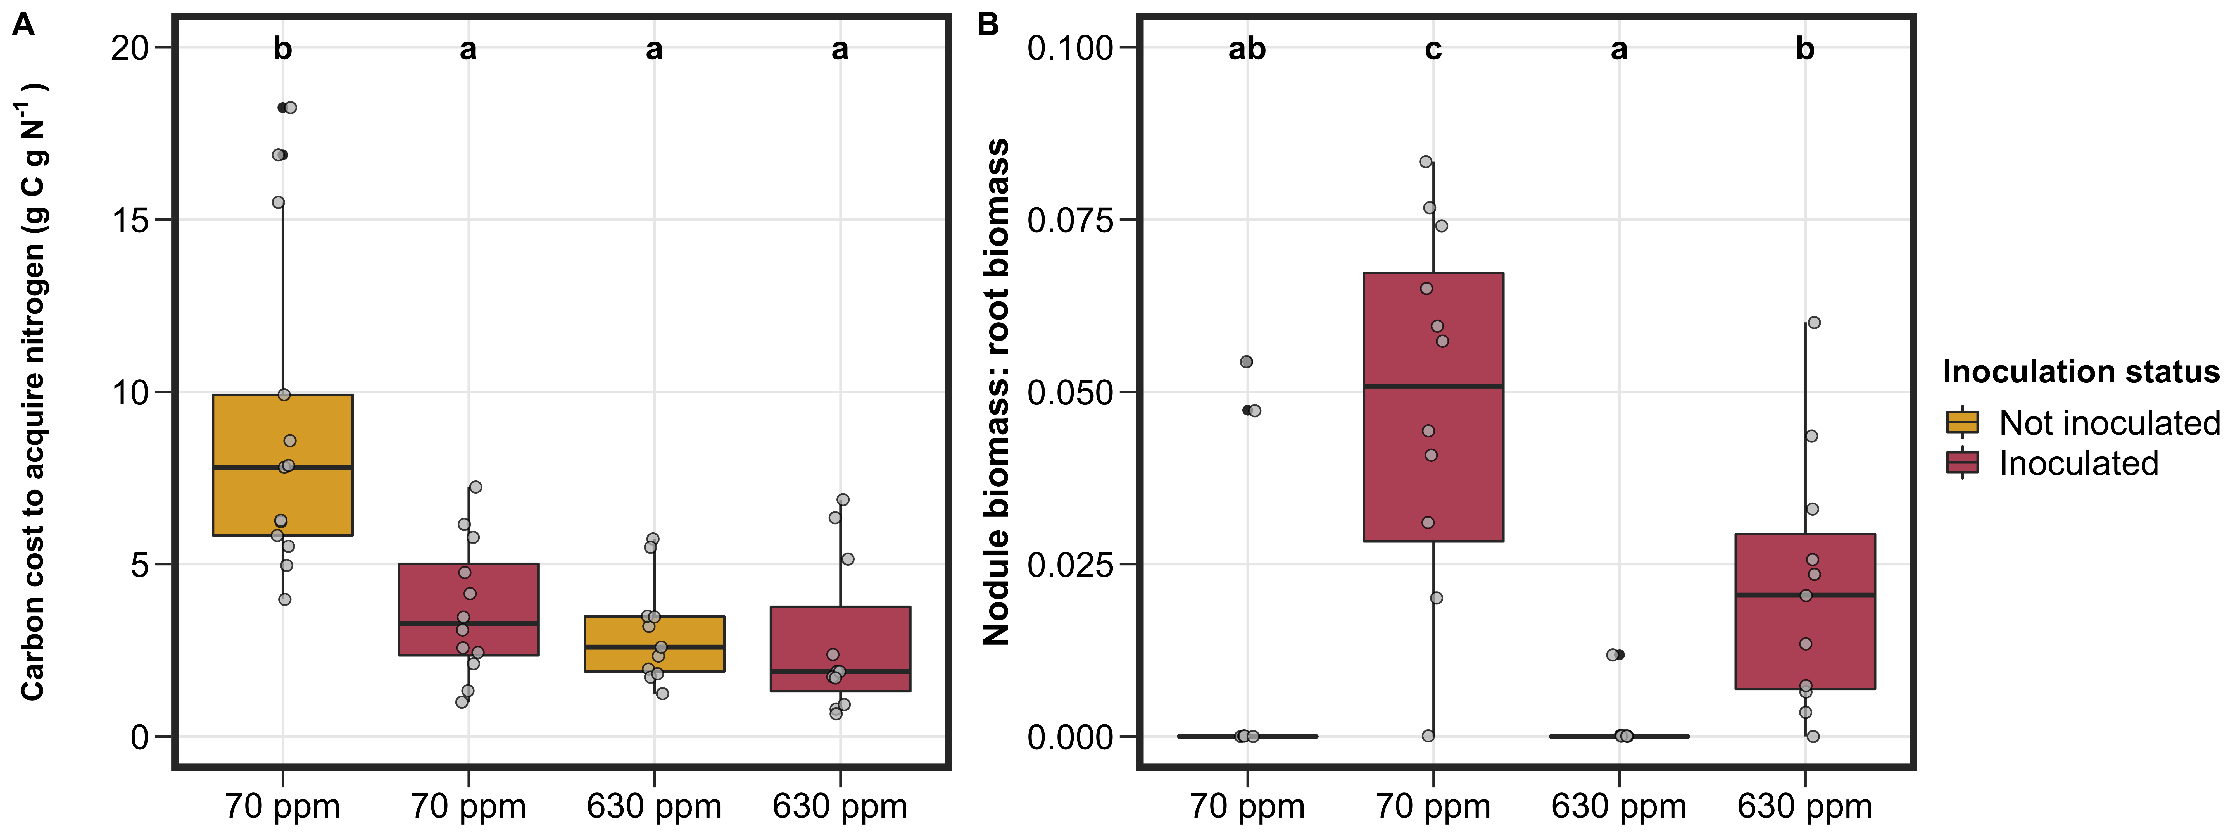
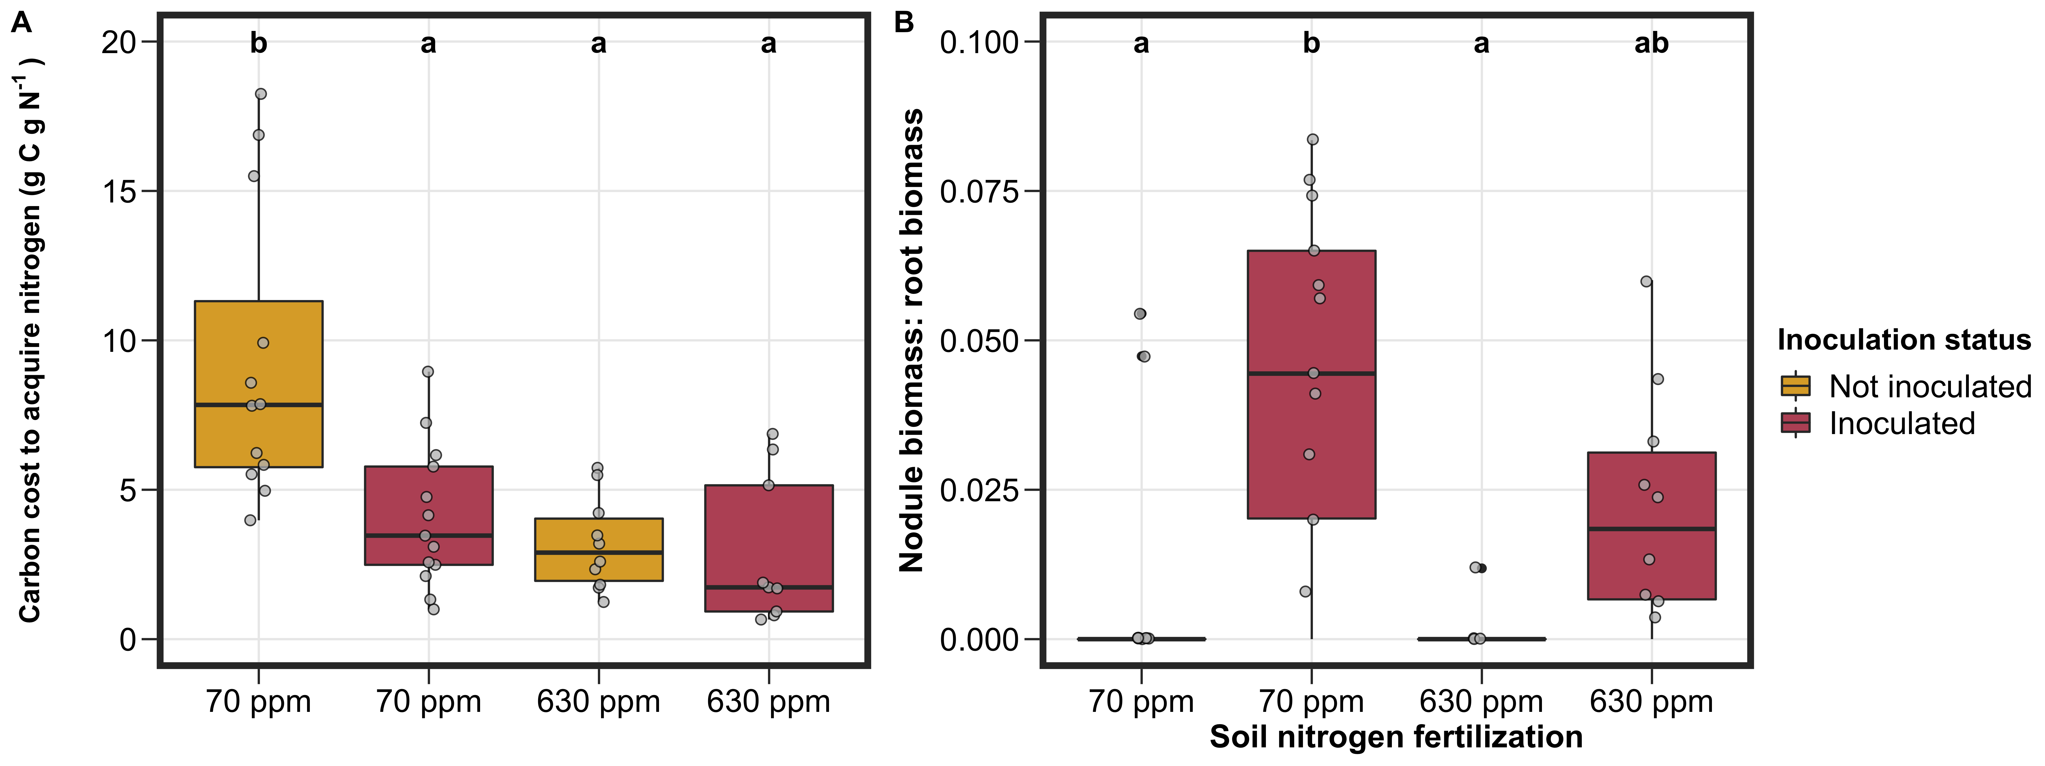
Notes:
Orient figures for rest of experiment

Slide 29
Soil nitrogen availability generally decreased carbon costs to acquire nitrogen
Notes:
In line with previous experiments, carbon costs to acquire nitrogen generally decreased with increasing nitrogen fertilization

Slide 30
Inoculation status generally decreased carbon costs to acquire nitrogen, but only under low soil nitrogen…
Notes:
We also observed an interaction between nitrogen fertilization and inoculation status, where inoculation status only decreased carbon costs to acquire nitrogen under low soil nitrogen
We calculated the nodule biomass: root biomass ratio to see if this might be driven by a shift toward direct uptake…

Slide 31
… a pattern driven by a likely shift toward direct uptake at high soil nitrogen
Notes:
And indeed found that inoculated individuals had lower nodule biomass relative to root biomass under the high soil nitrogen treatment
These results indicate that individuals were investing less in root nodules under high soil nitrogen, potentially relying more on direct uptake for nutrient acquisition
This figure also indicates that the inoculation treatments generally worked, where there were only a few individuals in the non-inoculated group that formed root nodules

Slide 32
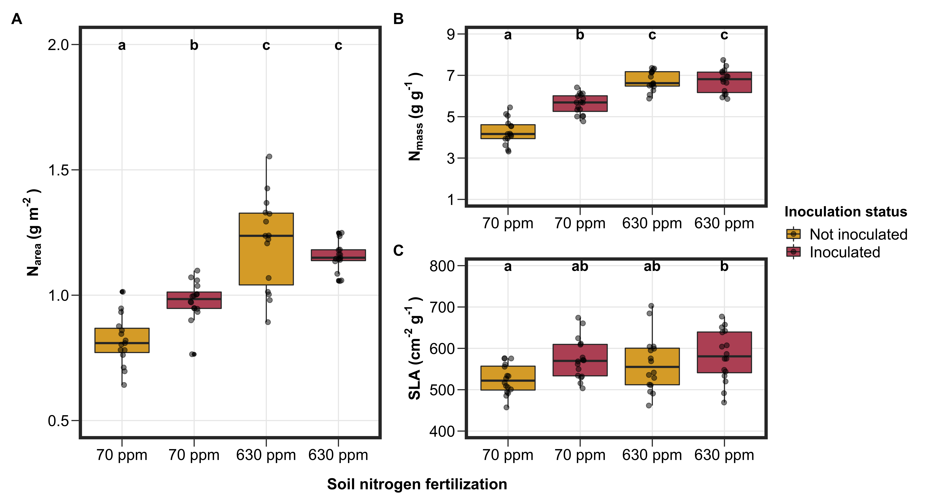
Notes:
Soil nitrogen fertilization and inoculation status modified carbon costs to acquire nitrogen according to what we had expected
Next, we were interested in understanding how these changes corresponded to leaf water-nutrient economics and tradeoffs between leaf nitrogen allocation and whole plant growth

Slide 33
Soil nitrogen fertilization increased leaf nitrogen allocation, driven by increase in leaf nitrogen content over SLA
Notes:
We found that leaf nitrogen allocation followed similar patterns as carbon costs to acquire nitrogen
Soil nitrogen fertilization generally increased leaf nitrogen allocation, which was driven by a stimulation in leaf nitrogen allocation without a change in specific leaf area

Slide 34
Inoculation increased leaf nitrogen allocation under low soil nitrogen, again through an increase in leaf nitrogen content
Notes:
However, inoculation status increased leaf nitrogen allocation, but only under low soil nitrogen fertilization
Again, these patterns were driven by an increase in leaf nitrogen content, of which inoculation status also increased only under low soil nitrogen

Slide 35
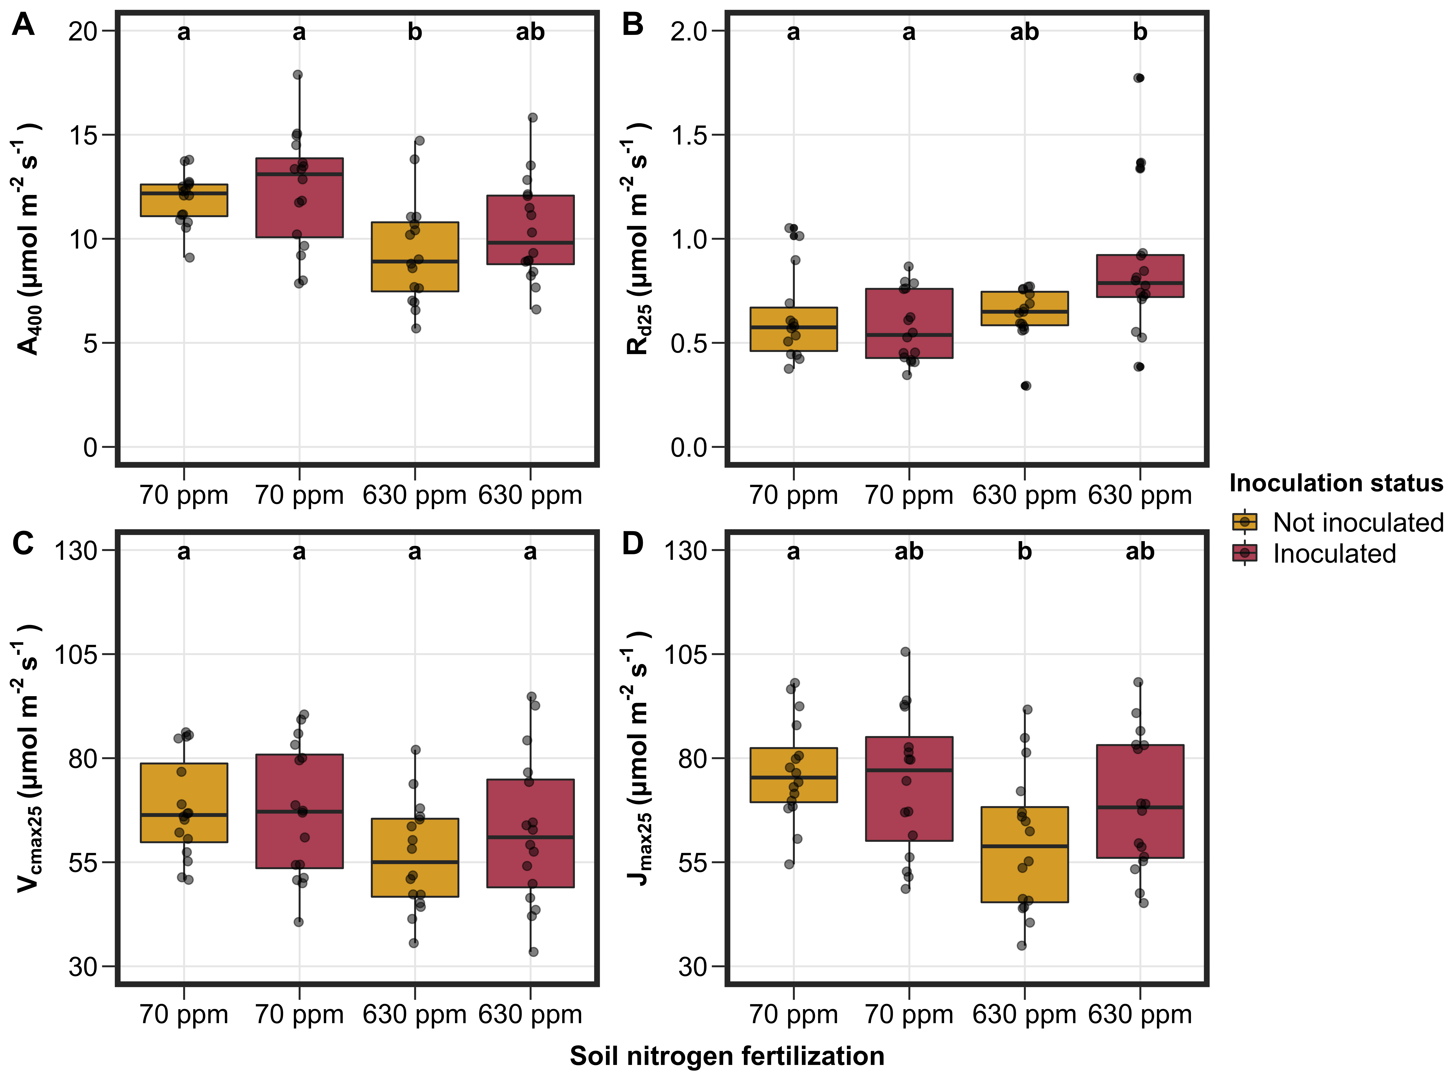
Soil nitrogen fertilization did not influence photosynthetic capacity, despite decreased leaf photosynthesis and increased dark respiration
Notes:
Despite an increase in leaf nitrogen allocation, we observed a reduction in net photosynthesis, Vcmax, and Jmax with increasing soil nitrogen.
Dark respiration generally increased with nitrogen fertilization, although there was a weak interaction that indicated a positive effect of inoculation on dark respiration under high soil nitrogen.
This could indicate larger maintenance costs of maintaining nitrogen fixation under conditions where such symbioses are not as beneficial
Inoculation status had no individual or interactive effect on any photosynthetic parameters

Slide 36
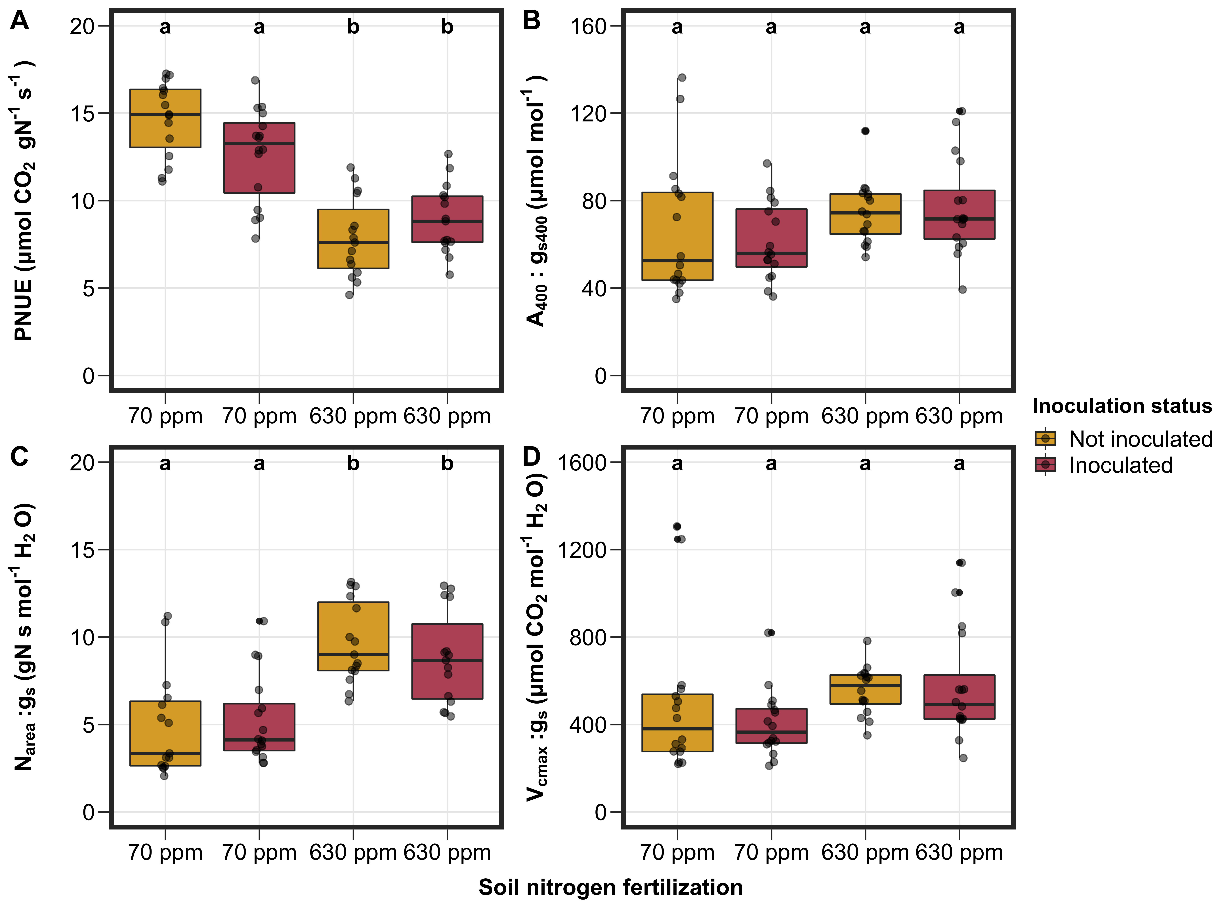
Soil nitrogen fertilization decreased nitrogen use efficiency, but did not change water use efficiency
Notes:
The stimulation in leaf nitrogen allocation and reduction in net photosynthesis led to a reduction in photosynthetic nitrogen-use efficiency with increased soil nitrogen fertilization
However, photosynthetic nitrogen-use efficiency was driven by an interaction between inoculation and soil nitrogen,
The interaction indicated that inoculation status decreased photosynthetic nitrogen-use efficiency under low nitrogen, but increased photosynthetic nitrogen-use efficiency under high soil nitrogen
While this doesn’t pop up on the compact lettering, water-use efficiency increased with increasing nitrogen fertilization, with no individual or interactive effect of inoculation

Slide 37
However, soil nitrogen fertilization did increase leaf nitrogen allocation per stomatal conductance
Notes:
The reduction in nitrogen use efficiency paired with a reduction in water use efficiency increased leaf nitrogen allocation per stomatal conductance; however, had no effect on Vcmax per stomatal conductance
These findings indicate patterns consistent with photosynthetic least-cost theory.
They also suggest that nitrogen fixation may modify the effect of soil nitrogen availability on nitrogen-use efficiency, therefore should modify the magnitude of nitrogen-water use tradeoffs at a given soil nitrogen level

Slide 38
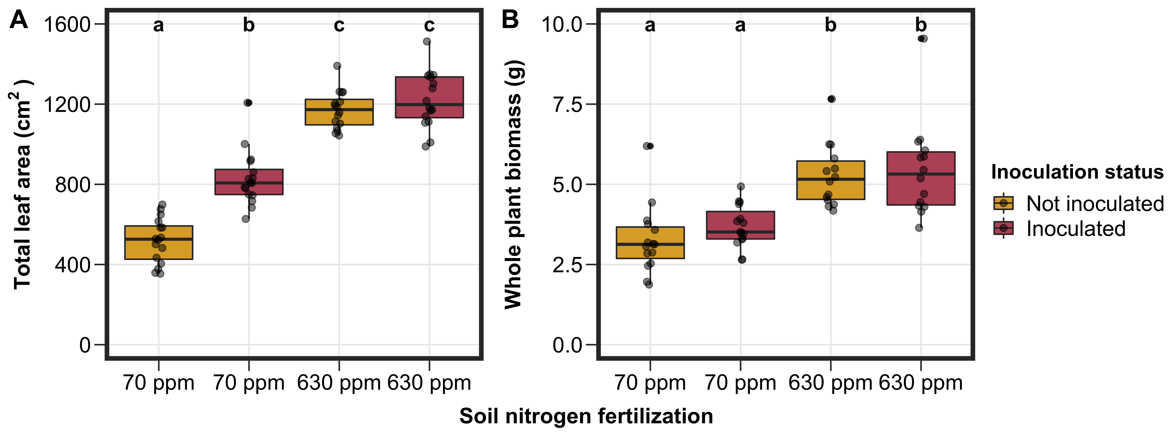
Nitrogen fertilization increased total leaf area and whole plant biomass
Notes:
At the whole plant level, soil nitrogen fertilization generally increased total leaf area and whole plant biomass.

Slide 39
Inoculation status increased total leaf area under low soil nitrogen, but did not affect whole plant biomass
Notes:
However, total leaf area was driven by an interaction between soil nitrogen fertilization and inoculation status, where inoculation status only increased total leaf area under low soil nitrogen.
We observed no such interaction for whole plant biomass
These findings could suggest a possible mechanism for plants to produce additional photosynthate to satisfy nutrient exchange requirements under low soil nitrogen?
Alternatively, these findings could also suggest that plants are investing in leaf production as leaf nutrient demand may already be met

Slide 40
Revisiting Research Questions
How does nitrogen fixation and soil nitrogen availability influence plant carbon costs to acquire nitrogen?
Notes:
So, Joseph, Nick, and I designed an experiment that would allow us to better target the role of species acquisition strategy and soil nitrogen fertilization on carbon costs to acquire nitrogen…

Slide 41
Revisiting Research Questions
How does nitrogen fixation and soil nitrogen availability influence plant carbon costs to acquire nitrogen?
Soil nitrogen availability decreased carbon costs to acquire nitrogen
Notes:
So, Joseph, Nick, and I designed an experiment that would allow us to better target the role of species acquisition strategy and soil nitrogen fertilization on carbon costs to acquire nitrogen…

Slide 42
Revisiting Research Questions
How does nitrogen fixation and soil nitrogen availability influence plant carbon costs to acquire nitrogen?
Soil nitrogen availability decreased carbon costs to acquire nitrogen
Inoculation status decreased carbon costs to acquire nitrogen, but only under low soil N
Notes:
So, Joseph, Nick, and I designed an experiment that would allow us to better target the role of species acquisition strategy and soil nitrogen fertilization on carbon costs to acquire nitrogen…

Slide 43
Revisiting Research Questions
How does nitrogen fixation and soil nitrogen availability influence plant carbon costs to acquire nitrogen?
Soil nitrogen availability decreased carbon costs to acquire nitrogen
Inoculation status decreased carbon costs to acquire nitrogen, but only under low soil N
How does nitrogen fixation and soil nitrogen availability modify leaf nitrogen-water economics?
Notes:
So, Joseph, Nick, and I designed an experiment that would allow us to better target the role of species acquisition strategy and soil nitrogen fertilization on carbon costs to acquire nitrogen…

Slide 44
Revisiting Research Questions
How does nitrogen fixation and soil nitrogen availability influence plant carbon costs to acquire nitrogen?
Soil nitrogen availability decreased carbon costs to acquire nitrogen
Inoculation status decreased carbon costs to acquire nitrogen, but only under low soil N
How does nitrogen fixation and soil nitrogen availability modify leaf nitrogen-water economics?
Soil nitrogen availability increased water-use efficiency, decreased nitrogen-use efficiency, and increased leaf nitrogen per stomatal conductance
Notes:
So, Joseph, Nick, and I designed an experiment that would allow us to better target the role of species acquisition strategy and soil nitrogen fertilization on carbon costs to acquire nitrogen…

Slide 45
Revisiting Research Questions
How does nitrogen fixation and soil nitrogen availability influence plant carbon costs to acquire nitrogen?
Soil nitrogen availability decreased carbon costs to acquire nitrogen
Inoculation status decreased carbon costs to acquire nitrogen, but only under low soil N
How does nitrogen fixation and soil nitrogen availability modify leaf nitrogen-water economics?
Soil nitrogen availability increased water-use efficiency, decreased nitrogen-use efficiency, and increased leaf nitrogen per stomatal conductance
Inoculation decreased nitrogen-use efficiency under low N and increased nitrogen-use efficiency under high N, but had no effect on water use efficiency or leaf nitrogen per stomatal conductance
Notes:
So, Joseph, Nick, and I designed an experiment that would allow us to better target the role of species acquisition strategy and soil nitrogen fertilization on carbon costs to acquire nitrogen…

Slide 46
Revisiting Research Questions (cont.)
How does nitrogen fixation and soil nitrogen availability modify tradeoffs between leaf nitrogen allocation and whole plant growth?
Soil nitrogen availability increased total leaf area and whole plant biomass
Notes:
So, Joseph, Nick, and I designed an experiment that would allow us to better target the role of species acquisition strategy and soil nitrogen fertilization on carbon costs to acquire nitrogen…

Slide 47
Revisiting Research Questions (cont.)
How does nitrogen fixation and soil nitrogen availability modify tradeoffs between leaf nitrogen allocation and whole plant growth?
Soil nitrogen availability increased total leaf area and whole plant biomass
Inoculation status increased total leaf area, but only under low nitrogen
Notes:
So, Joseph, Nick, and I designed an experiment that would allow us to better target the role of species acquisition strategy and soil nitrogen fertilization on carbon costs to acquire nitrogen…

Slide 48
Revisiting Research Questions (cont.)
How does nitrogen fixation and soil nitrogen availability modify tradeoffs between leaf nitrogen allocation and whole plant growth?
Soil nitrogen availability increased total leaf area and whole plant biomass
Inoculation status increased total leaf area, but only under low nitrogen
Inoculation status did not influence whole plant growth
Notes:
So, Joseph, Nick, and I designed an experiment that would allow us to better target the role of species acquisition strategy and soil nitrogen fertilization on carbon costs to acquire nitrogen…

Slide 49
Revisiting Research Questions (cont.)
How does nitrogen fixation and soil nitrogen availability modify tradeoffs between leaf nitrogen allocation and whole plant growth?
Soil nitrogen availability increased total leaf area and whole plant biomass
Inoculation status increased total leaf area, but only under low nitrogen
Inoculation status did not influence whole plant growth
Individuals invested more in leaf production than individual leaf productivity
under conditions that confer reduced carbon costs to acquire nitrogen
Notes:
So, Joseph, Nick, and I designed an experiment that would allow us to better target the role of species acquisition strategy and soil nitrogen fertilization on carbon costs to acquire nitrogen…

Slide 50
Future work
δ¹³C from focal leaves to calculate β and χ across treatment combinations?
At what point do nitrogen-fixing species shift from nitrogen fixation to direct uptake?
Upcoming CO₂ experiment with 9 soil nitrogen treatments will help tease this apart
Leverage FUN 2.0 model for model-data comparison?
Notes:
We did not compare carbon costs to acquire nitrogen between species.
This is because cotton and soybean are not phylogenetically related and we are extremely limited in our ability to extrapolate these patterns to all nitrogen-fixing or non nitrogen-fixing species.
Therefore, future work will entail using a larger range of taxonomically related species to determine how generalizable these patterns are.
Additionally, this study was conducted over a short 5-week temporal scale, so there is also a need to evaluate these patterns across multiple spatiotemporal scales to determine the spatiotemporal range for which these patterns hold
Finally, we would love to evaluate the soil nitrogen threshold whereby nitrogen-fixing species shift from nitrogen fixation to direct uptake and to compare these results to patterns simulated by Earth system models.

Slide 51
Future work
δ¹³C from focal leaves to calculate β and χ across treatment combinations?
At what point do nitrogen-fixing species shift from nitrogen fixation to direct uptake?
Upcoming CO₂ experiment with 9 soil nitrogen treatments will help tease this apart
Leverage FUN and FUN 2.0 model for model-data comparison?
Notes:
We did not compare carbon costs to acquire nitrogen between species.
This is because cotton and soybean are not phylogenetically related and we are extremely limited in our ability to extrapolate these patterns to all nitrogen-fixing or non nitrogen-fixing species.
Therefore, future work will entail using a larger range of taxonomically related species to determine how generalizable these patterns are.
Additionally, this study was conducted over a short 5-week temporal scale, so there is also a need to evaluate these patterns across multiple spatiotemporal scales to determine the spatiotemporal range for which these patterns hold
Finally, we would love to evaluate the soil nitrogen threshold whereby nitrogen-fixing species shift from nitrogen fixation to direct uptake and to compare these results to patterns simulated by Earth system models.

Slide 52
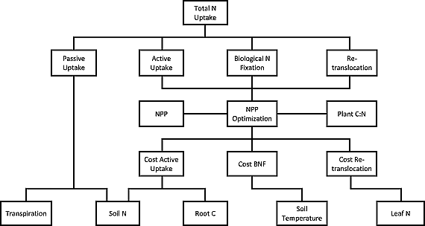
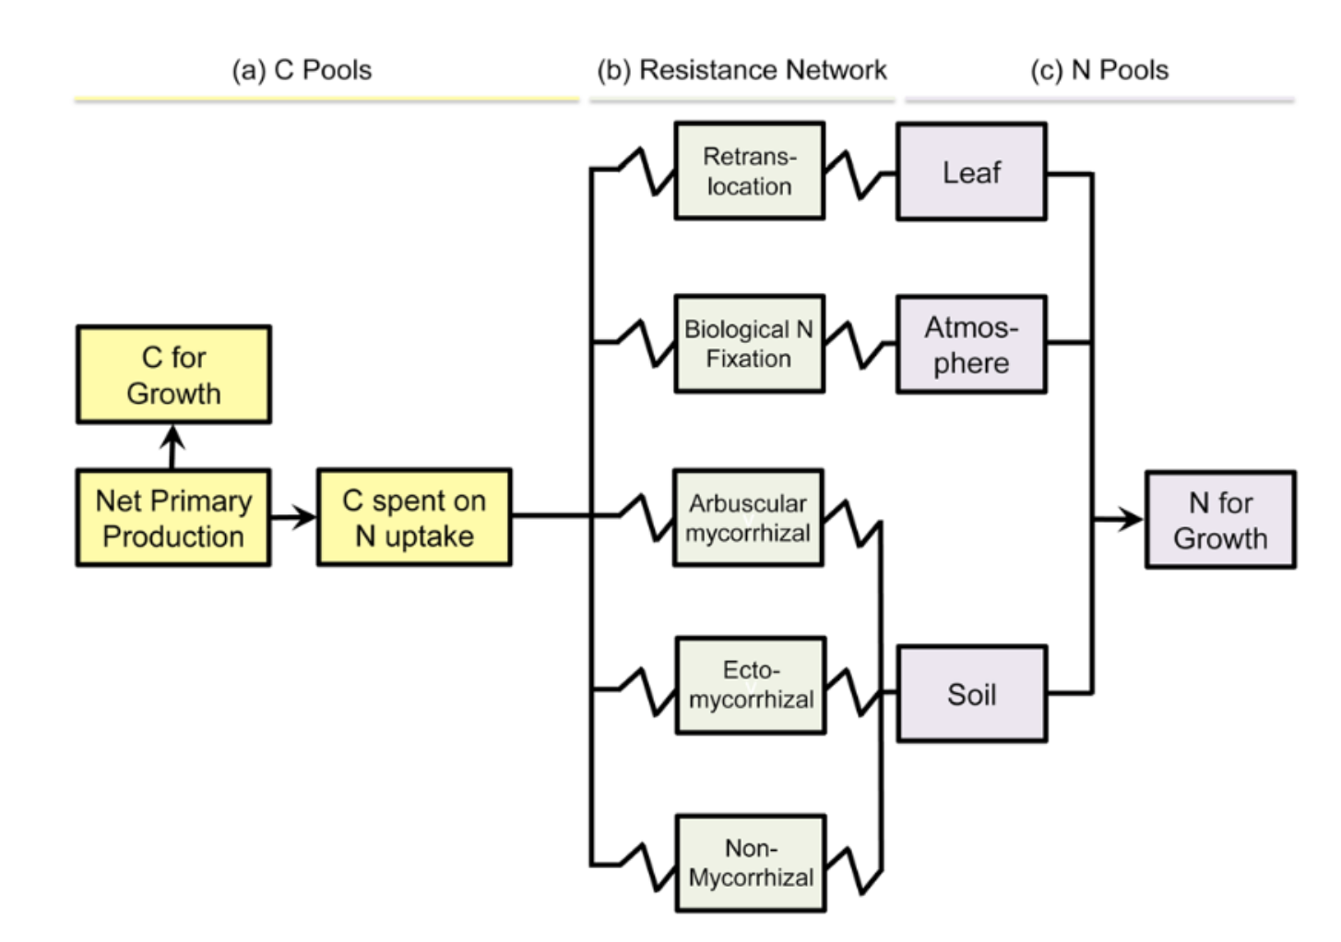
Future work
δ¹³C from focal leaves to calculate β and χ across treatment combinations?
At what point do nitrogen-fixing species shift from nitrogen fixation to direct uptake?
Upcoming CO₂ experiment with 9 soil nitrogen treatments will help tease this apart
Leverage FUN and FUN 2.0 model for model-data comparison?
Fisher et al. (2010) Global Biogeochemical Cycles; Brzostek et al. (2014) JGR: Biosciences
Notes:
We did not compare carbon costs to acquire nitrogen between species.
This is because cotton and soybean are not phylogenetically related and we are extremely limited in our ability to extrapolate these patterns to all nitrogen-fixing or non nitrogen-fixing species.
Therefore, future work will entail using a larger range of taxonomically related species to determine how generalizable these patterns are.
Additionally, this study was conducted over a short 5-week temporal scale, so there is also a need to evaluate these patterns across multiple spatiotemporal scales to determine the spatiotemporal range for which these patterns hold
Finally, we would love to evaluate the soil nitrogen threshold whereby nitrogen-fixing species shift from nitrogen fixation to direct uptake and to compare these results to patterns simulated by Earth system models.

Slide 53
That’s all, folks!

